Slide 1
SPONDYLOARTHROPATHY
Dr.S.A.F.Kurukulasuriya

Slide 2
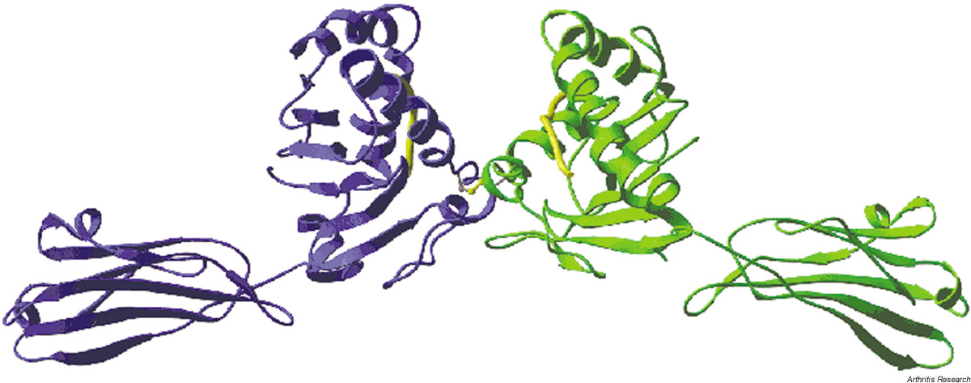
Introduction
Inflammatory joint disease of the vertebral column associated with MHC class I molecule HLA-B27.

Slide 3


Slide 4
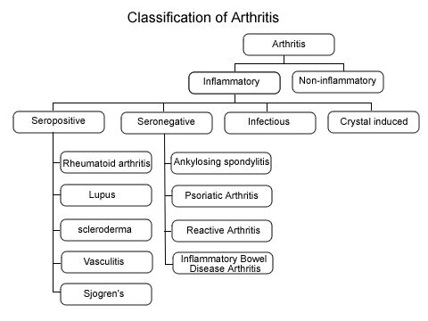

Slide 5
Subgroups
Ankylosing Spondylitis
Reactive arthritis
Enteropathic arthritis
Psoriatic arthritis
Isolated acute anterior uveitis
Undifferentiated SpA

Slide 6
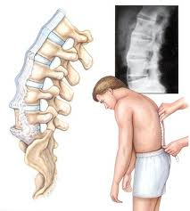
Ankylosing spondylitis

Slide 7
Introduction
Chronic inflammatory arthritis
Autoimmune disease
Mainly affects joints in the spine and the sacroilium.
May cause eventual fusion of the spine.

Slide 8
Pathophysiology
Systemic rheumatic disease.
A seronegative spondyloarthropathy.
90% express HLA-B27 genotype.
TNF-alpha and IL-1 is implicated.
ANCA (Anti neurtophil cytoplasmic antibody) antibodies are associated.

Slide 9
Signs and symptoms
Typically young male 18-30 yrs.
Male : Female=3:1
More painful course in males.
Chronic pain and stiffness of the lower part of the spine
Before 18 yrs → pain and swelling of large limb joints esp-knee.
enthesiitis

Slide 10
Signs and symptoms contd..
Generalized fatigue and nausea.
Severe pain at rest, improves with activity.
40% -Iridocyclitis and Anterior uveitis (redness, eye pain, vision loss, floaters photophobia)
Aortitis
Apical fibrosis
Onycholysis

Slide 11
Diagnosis
No direct test to diagnose.
Clinical examination-Schobers test.
ESR and CRP may some times be elevated.
X-ray changes-may appear only 8-10 yrs after symptoms.
Spinal changes-blurring of the upper and lower vertebral rims at the TL junction.

Slide 12
Diagnosis contd..
Romanus sign
Spinal changes-syndesmophytes, disc is preserved.
Bamboo spine-calcification of the intervertebral ligaments
Sacroiliitis
HLA B-27 positivity

Slide 13
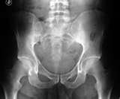

Slide 14

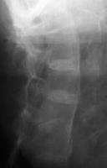

Slide 15
Treatment
No known cure,but symptoms could be controlled and pain reduced.
Physical therapy &exercise (swimming benificial, avoid jogging)
Medication.
Walking aids.

Slide 16
Medication
Anti inflammatory drugs-NSAIDS, opioid analgesics(esp. time release formulations)
Conventional DMARDS-Not effective in axial involvement (Ciclosporin,MTX,SSZ,Corticosteroids)
Biologicals TNF –alpha blockers (etanercept,infliximab,adalimumab)

Slide 17
Surgery
Joint replacements-knees and hips.
Surgical correction of flexed spine.
Anaesthetic difficulties -intubation difficulties,spinal and epidural difficult due to calcification of ligaments

Slide 18
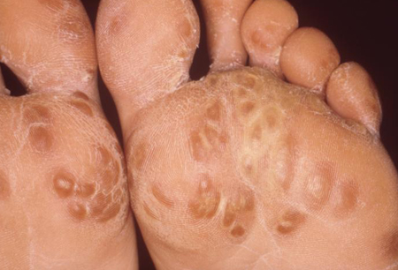
Reactive arthropathy

Slide 19
Introduction
Autoimmune process
Develops in response to an infection (GU/STD) ,1-3 weeks after.
20-40 yrs.
> in males.
> in caucasians.
HIV-increased risk.

Slide 20
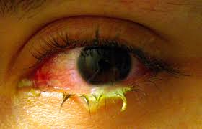
Signs and symptoms
3 seemingly unlinked symptoms
Inflammatory arthritis of large joints.
Conjunctivitis/uveitis
Urethritis
Skin-Circinate balanitis,keratoderma blenorrhagica.
Aortic regurgitation.

Slide 21
Diagnosis
MRI
Swab-urethra,cervix,throat→culture (campylobacter jejuni,salmonella,shigella)
Urine and stool samples
HLA B27 positive

Slide 22
Treatment
App. antibiotics if organisms still present.
Symptomatic treatment-
analgesics
Steroids
immunosuppressives

Slide 23
Prognosis
Self limiting usually, few weeks- 6 months/
Frequently recurring/
Chronic/
Progressive.

Slide 24
Enteropathic arthritis

Slide 25
Introduction
Arthritis associated with inflammatory bowel disease.
Autoimmune process.
20% of crohns /ulcerative colitis patients.
Multiple peripheral joints (KJ,AJ,EJ,WJ) affected.
5%- spine affected.

Slide 26
Introduction contd…
Males = Females
> teenagers and young adults.
Cause not known.
Joint symptoms usually during flare of IBD.
No destruction/deformity of joints.

Slide 27
Introduction contd…
Males = Females
> teenagers and young adults.
Cause not known.
Joint symptoms usually during flare of IBD.
No destruction/deformity of joints.

Slide 28
Diagnosis
X-rays
Synovial fluid
Blood tests
Need to exclude conditions which share similar symptoms.

Slide 29
Treatment
Treat underlying condition.
Treat any remaining symptoms-
NSAIDS
Corticosteroids
Immunosuppressives –SSZ
TNF inhibitors – Infliximab
Physiotherapy and exercise
Surgery-remove the colon

Slide 30
Psoriatic arthritis

Slide 31
Introduction
Chronic progressive disease.
Equally common in both sexes.
4th and 5th decades.
Most often skin disease is diagnosed first.
Joint disease may precede skin disease.

Slide 32
Symptoms
Joint pain, stiffness and swelling.
Progressive.May have periods of remission.
Skin and joint symptoms appear and disappear at the same time.

Slide 33
Types of arthritis
Asymmetrical oligo arthritis.
Symmetrical arthritis.
DIP involvement.
Spondyloarthopathy.
Arthritis mutilans.

Slide 34
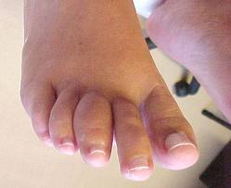
Asymmetrical oligo arthritis
Mildest form
< 5 joints.
One side of the body/different joints of each side of the body. (HJ,KJ,WJ)
Dactylitis –swelling or inflammation of the tendons.

Slide 35
Symmetrical arthritis
5 or more joints.
>in females.
Associated with more severe skin disease.

Slide 36
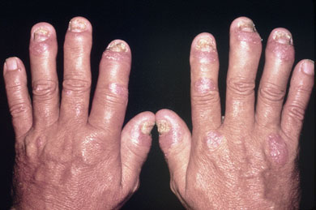
DIP involvement.
Rare.
More in males.
Nail involvement occurs.

Slide 37
Spondyloarthropathy
Spine,lower back and SIJs involved.
> common in males.

Slide 38
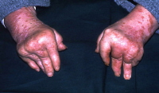
Arthritis mutilans
Small percentage.
Severe, painful disabling form.

Slide 39
Causes
Autoimmune aetiology.
Some genetic markers appear to be associated.

Slide 40
Risk factors
Skin psoriasis.
Family history.
Age 30-50 yrs.
Both sexes affected equally.

Slide 41
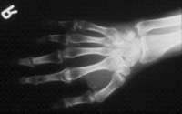
Diagnosis
X-rays
Joint fluid test
ESR-non specific
Rheumatoid factor

Slide 42
Treatment
No cure.
Medication- control inflammation (prevent pain and disability).
Physiotherapy and exercises.
Life style factors – (ex.maintaining a healthy weight)

Slide 43
Medication
NSAIDS
Corticosteroids- oral/injectable
DMARDS –SSZ, MTX
Immunosuppressives –AZA, Cyclophosphamide, leflunamide
TNF alpha blockers –etanercept, adalimumab, infliximab

